Slide 1

Megan Holford
Predicting World Happiness

Slide 2
World Happiness
Can you predict a country’s Happiness score?
Some of the cases this information can be used for are:
Creating or expanding new government policy,
Seeing how GDP may relate to the happiness of citizens and their health
How these factors relate to the idea of happiness in psychology.

Slide 3
Data
My data is available here from Kaggle: :https://www.kaggle.com/mathurinache/world-happiness-report#__sid=js0
This data covers the years from 2015 to 2020 for 153 countries and territories.
Data collected from the Gallup World Poll which surveys approximately 1,000 per country ages 15+.

Slide 4
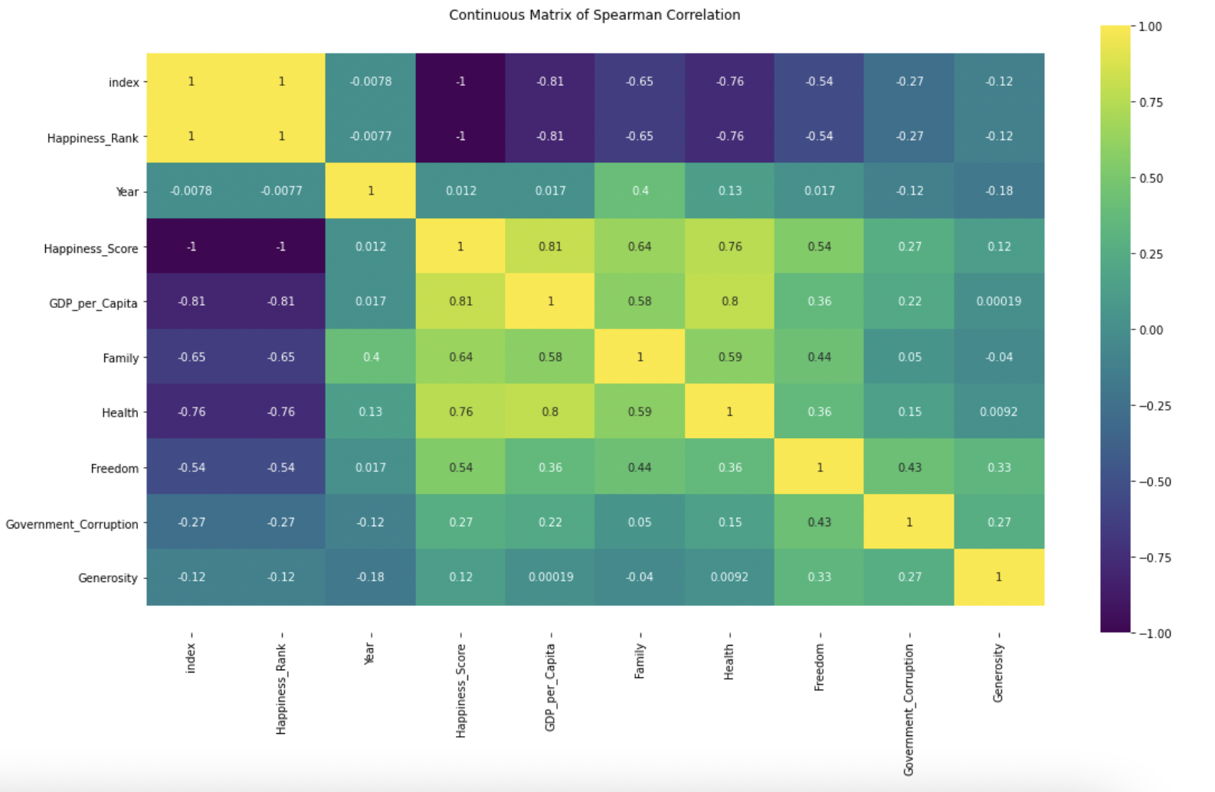
Per this chart, we can see that some variables like GDP, Health and Family have a
higher correlation to the overall Happiness Score than variables like Generosity and Trust.

Slide 5
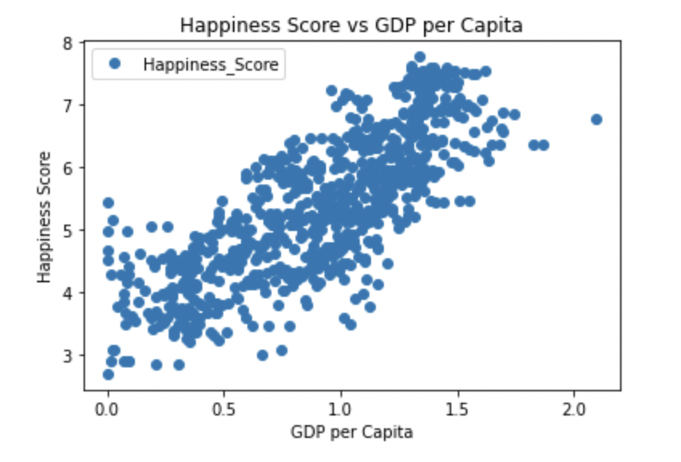
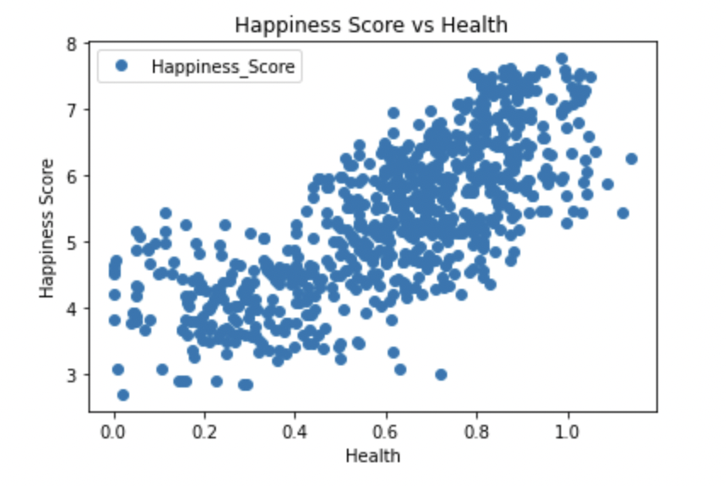
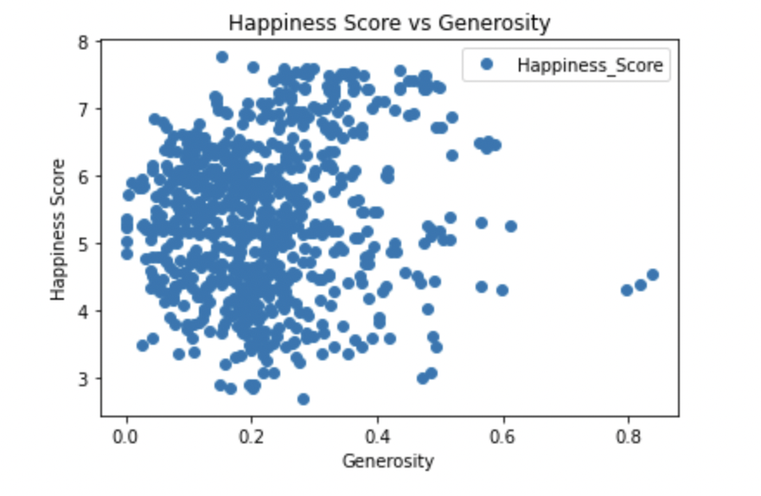
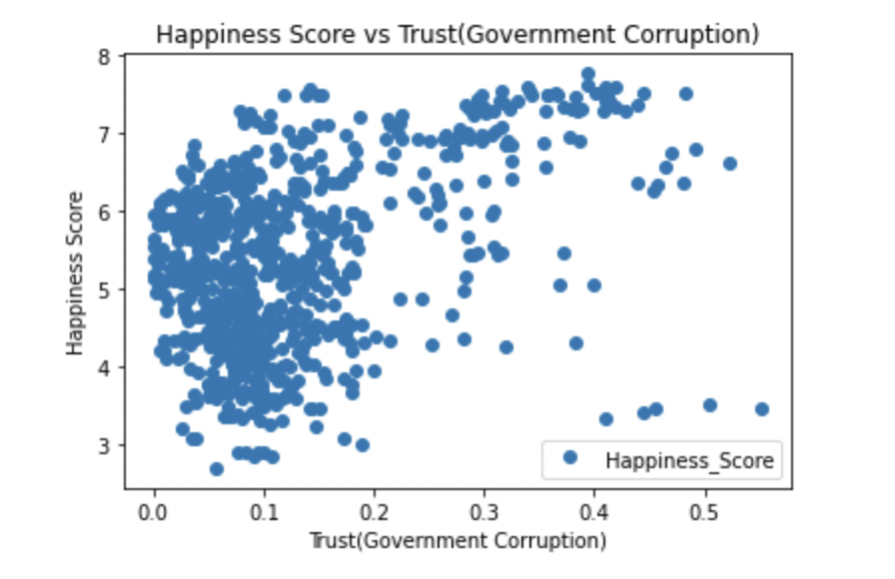
After getting an idea of the variables that have a stronger relationship, we can do a bit more analysis
Based on the scatterplots, we can see that there is more of a linear relationship between Happiness Score and GDP, Health, and Family. The relationship between Happiness Score and Generosity and Trust is not very strong and non-linear.

Slide 6
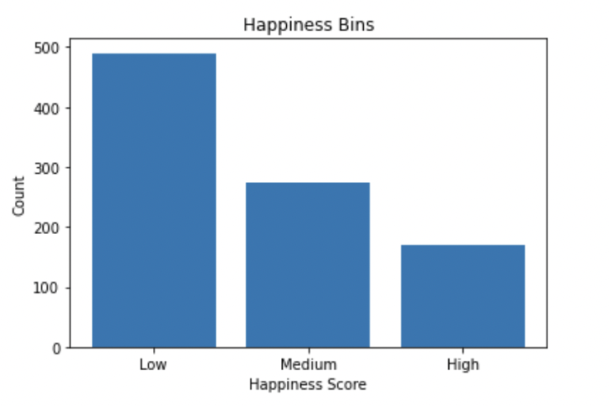

Slide 7
Linear Regression:
Random Forest:
Training R2: 75%
Test R2: 76%
Training R2: 96%
Test R2: 82%

Slide 8
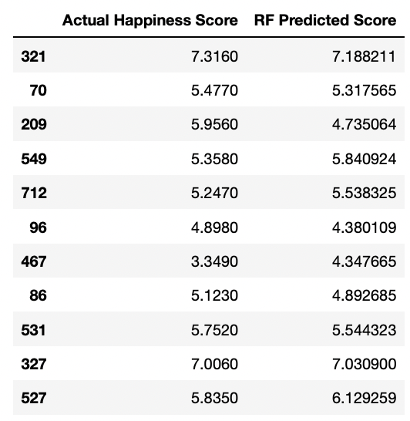
Model Results

Slide 9
Looking Further…
While the model made predictions that were close to the actual happiness score, there is still definitely room for improvement. This is a yearly report that is done and so as more data is made available, it can be used to help train the model.

Slide 10
References
Gallup. (2019, February 14). How does the Gallup World Poll Work? Gallup.com.
Retrieved November 18, 2021, from
https://www.gallup.com/178667/gallup-world-poll-work.aspx.
https://www.kaggle.com/mathurinache/world-happiness-report#__sid=js0
https://worldhappiness.report
Coding can be found at this repository:
https://github.com/mholford91/DSC-630/blob/main/Project/Milestone%204.ipynb

